Slide 1
Multimodal World Models In Healthcare Using Joint-Embedding Predictive Architecture
23AID498 Project Phase 1 – Review-2 Presentation
Team ID: 23UG083 Panel No. - 02
S.No | Reg.No | Name of the Student | Branch
1 | BL.EN.U4AID23002 | Adithya Nair | AIDS
2 | BL.EN.U4AID23005 | Avighna Reddy Katipally | AIDS
Project Guide: Dr. Manju Venugopalan
Assistant Professor(Sl.Gr), School of Computing, Bengaluru

Slide 2
Mentor Approval

Slide 3
Problem Definition (edit later)
Generative models such as transformers, VAEs and diffusion models tend to produce outputs that seem plausible yet untrue:
  They do not learn the dynamics of a patient's condition.
  This leads to a risk of outputs that can mislead medical experts and harm the lives of patients.
Current models tend to focus on data of only one modality:
  Clinical notes and interventions are often ignored while predicting a disease's trajectory which provide context necessary to correctly interpret a patient's condition.
Models that operate on a single timepoint of a medical image lack any context about how the patient's condition evolves over time :
  Longitudinal data contains very useful information about how a patient's condition evolves over time.
  This data (with clinical notes) provides context about the effects of an intervention on a patient's condition over time.
  Thus, there is a need for models that are grounded in the patient's dynamics, trained across multiple modalities and accurately model the evolution of the patient's condition, including its response to treatment, over time.

Slide 4
Literature Survey Summary
Vision-language and dynamics models can support clinical decisions beyond image prediction.
Treatment-aware longitudinal data enables tumor prediction across treatments and timepoints.
Multimodal fusion improves information integration but may increase overfitting risk.
JEPA-based models learn generalizable latent medical representations.
Temporal-aware JEPA (TD-JEPA) shows that temporal information improves local representations and future-state prediction.

Slide 5
Research Gap & Justification
Current treatment-aware world models are mainly diffusion-based, making them compute-intensive and sample-inefficient.
Medical interventions are often not considered when predicting future tumor states from MRI.
No existing JEPA-based multimodal approach effectively models treatment-aware temporal representation using MRI + clinical text.
Proposed Research Gap:
A computationally efficient, treatment-aware multimodal world model is needed to learn longitudinal tumor progression from MRI and clinical information.

Slide 6
Data Set Candidates
SAILOR (v1)
Source of data set: https://search.kg.ebrains.eu/instances/cae85bcb-8526-442d-b0d8-a866425efff8
27 Patients with high-grade glioma
3-19 timepoint scans per patient during chemotherapy/chemoradiotherapy
Contains Structural and Functional MRI data
Annotations containing treatment status per timepoint
LUMIERE
Source of data set: https://www.nature.com/articles/s41597-022-01881-7
91 Patients with Glioblastoma
Clinical and pathology data, radiomics features, MRI acquisition information, the expert RANO rating
Contains structural MRI data only
Less detailed treatment info (no dose maps)

Slide 7
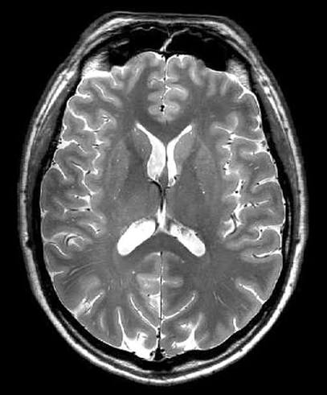
Data Set Sample (needed ?)
Patient: 001
Survival time (weeks): 89
Sex: female
Age at surgery (years): 57
IDH (WT: wild type): WT
IDH method: BES
MGMT qualitative: methylated
Clinical Metadata Sample
MRI Sample

Slide 8
Architecture
Same diagram with the changes
Brainaic , LoRa

Slide 9
Implementation: Data Processing
LUMIERE MRI data is downloaded and organized patient-wise and visit-wise.
Clinical information is integrated using:
  RANO ratings
  Demographics
  MRI acquisition parameters
  Sequence availability
SAILOR is maintained as an independent evaluation cohort.
Patient-level train/validation/test splitting is used to avoid patient leakage.

Slide 10
Implementation: MRI Preprocessing Pipeline
Raw MRI ➜
N4 Bias Field Correction: reduces intensity inhomogeneity
1 mm Isotropic Resampling: standardizes voxel spacing
Rigid MNI Registration: aligns scans spatially
HD-BET Skull Stripping: removes non-brain regions
96 × 96 × 96 Volume: standardizes model input
Non-zero Z-score Normalization: reduces intensity variation between scans
➜ BRAINIAC Input
Preprocessing makes MRI data compatible with the BRAINIAC backbone through spatial registration and intensity normalization.
It prevents the model from confusing scanner variations with actual biological tumor progression.

Slide 11
Implementation Details
MRI Feature Extraction
BRAINIAC 3D ViT-B is used as the MRI backbone.
Each MRI sequence is converted into a latent representation.
LoRA is used to adapt the pretrained backbone instead of training the entire model from scratch.
Per-sequence representations are subsequently combined with clinical features
Clinical Feature Encoding
Clinical variables are processed using dedicated MLP encoders.
Clinical information provides additional context about the patient's condition.
MRI and clinical representations are fused before temporal modelling

Slide 12
Implementation Details
Temporal Modelling
Representations from multiple visits are arranged chronologically.
A Temporal Transformer learns dependencies between visits.
Time-delta encoding (Δt) tells the model how much time has passed between consecutive scans.
The resulting representation captures the patient's longitudinal state.
JEPA Training
The temporal model predicts the latent representation of the next MRI visit.
A separate EMA target encoder generates the target representation from the actual future MRI.
A cosine JEPA loss aligns predicted and target representations.
The model is trained to predict future latent states rather than future pixels.

Slide 13
Initial JEPA Results
ahhhhhhhhh

Slide 14
Lesion-Aware Approach
ahhhhhh

Slide 15
Results
Key findings:

Slide 16
Conclusion
ahhhhhhhhhhh

Slide 17
THANK YOU

Slide 20
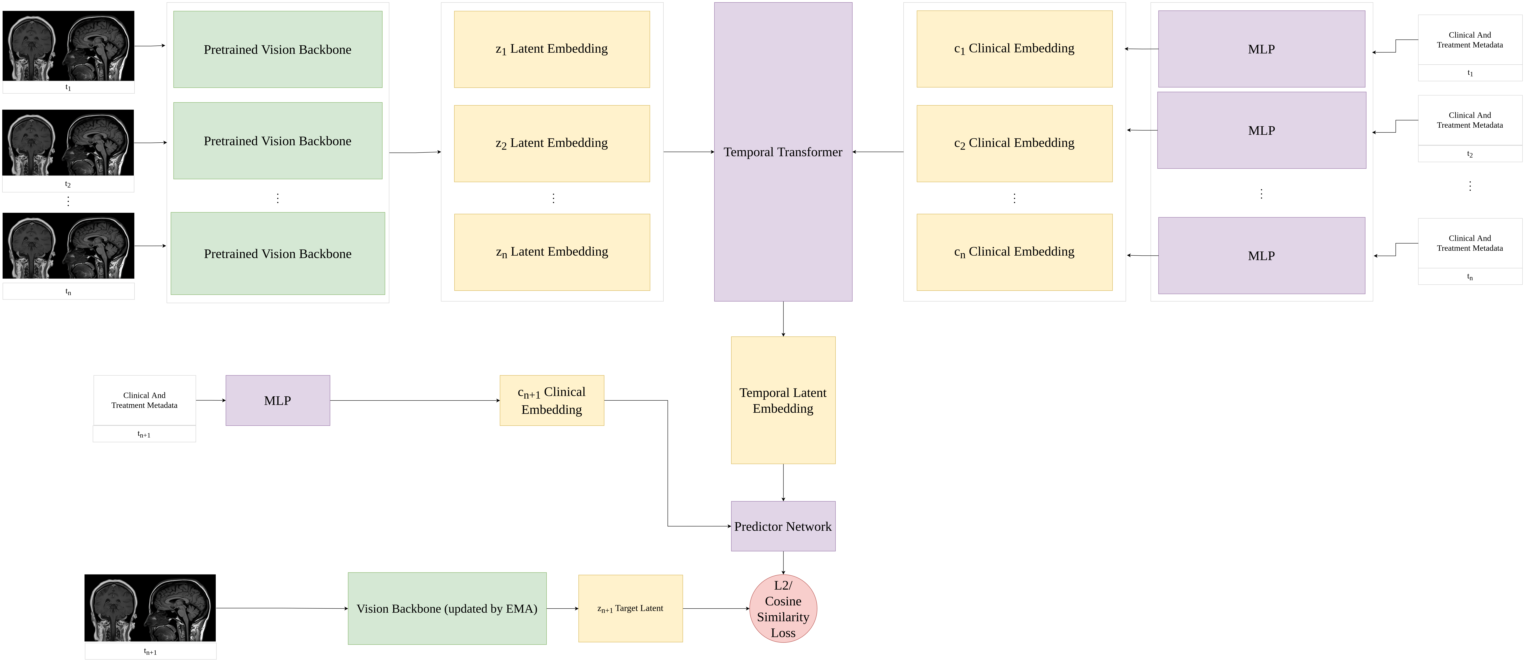
Architecture of the Proposed System

Slide 21
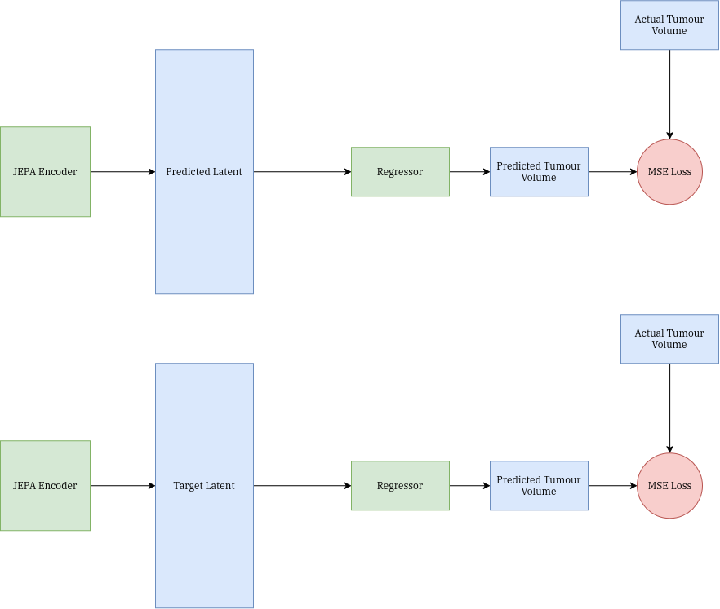
Architecture of the Proposed System
Downstream Task 1 – Tumour Volume Prediction

Slide 22
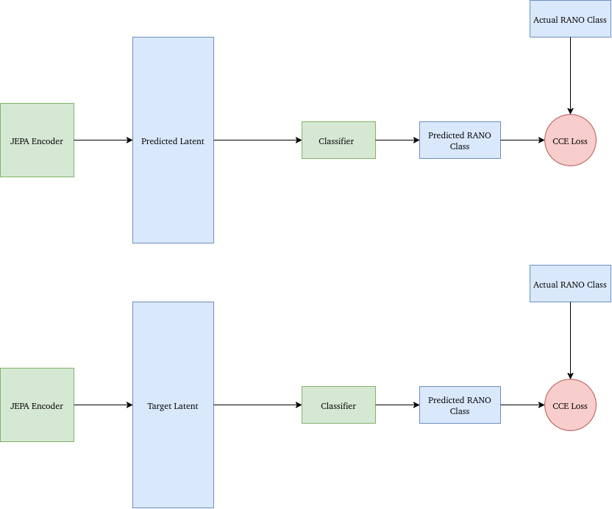
Architecture
Downstream Task 2 – RANO Classification

Slide 23
References
M. A. Qazi, M. Nadeem, and M. Yaqub, “Beyond Generative AI: World Models for Clinical Prediction, Counterfactuals, and Planning,” Nov. 20, 2025, arXiv: arXiv:2511.16333. doi: 10.48550/arXiv.2511.16333.
[9]
Y. Yue, Y. Wang, C. Tao, P. Liu, S. Song, and G. Huang, “CheXWorld: Exploring Image World Modeling for Radiograph Representation Learning”.
[10]
S. Huisman, N. Belkacemi, V. Keil, J. Verhoeff, and S. David, “Rectified flow-based prediction of post-treatment brain MRI from pre-radiotherapy priors for patients with glioma,” Rectified flow-based prediction of post-treatment brain MRI from pre-radiotherapy priors for patients with glioma, Mar. 2026.
[11]
D. Laslo et al., “Generative AI for spatial tumor growth on MRI: a proof-of-principle study in pediatric diffuse midline glioma,” BMC Med, vol. 24, no. 1, p. 389, May 2026, doi: 10.1186/s12916-026-04911-y.

